Slide 1
News Articles and Happiness
Rahul Vaswani, Sophia Huang, Saurabh Jaju, Mihir Sathe
W241 Fall 2018

Slide 2
Research Question
To what extent does reading a positive news article affect one's mood?
Happiness through a mass scale medium.

Slide 3
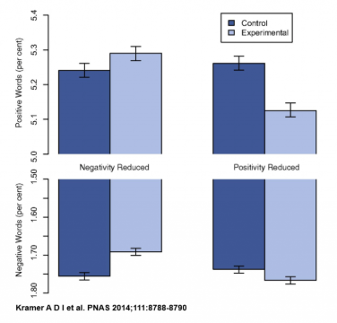
Why this Experiment?
A spin on the Facebook Experiment by Kramer, et. al (2013)
Facebook altered people’s moods via exposure to happy or sad items on one’s Newsfeed.
An overabundance of tragic news.

Slide 4
Why an Experiment?
The need for an intervention:
Giving one set of subjects a happy article and the other a neutral article allowed us to isolate the causal effect of happiness in our experiment.
The need for randomization:
Randomization prevents bias and provides controls for confounds and other externalities.

Slide 5
Hypothesis:
H₀: 𝛍_{Mood Difference}=0
H₁: 𝛍_{Mood Difference}≠0
Sharp Null Hypothesis
A subject’s mood does not change once exposed to a positive news article.
Alternative Hypothesis
There is a change in the subject’s mood once they are exposed to a positive news article.

Slide 6
Treatment and Control

Slide 7


Treatment
News articles were sourced from Reddit’s r/UpliftingNews.
Filtered for Top Articles (most upvoted) for the past month.
Allowed to get a “consensus” agreement of the positivity of the news article.

Slide 8
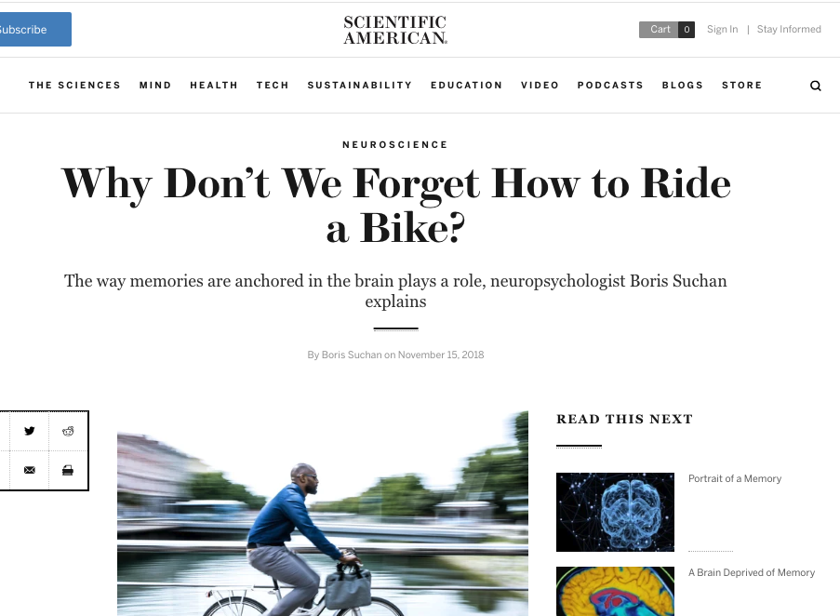
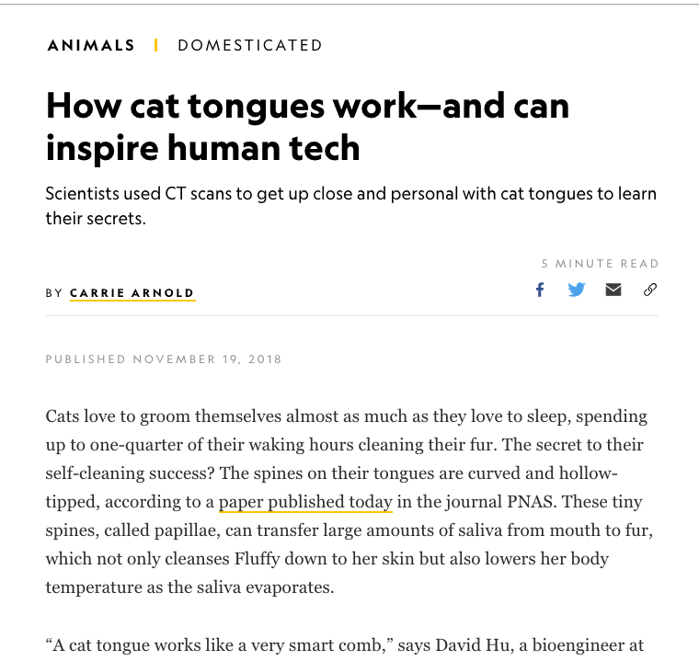
Control
The researchers manually selected articles with neutral tones and subjects.
Articles sourced from National Geographic, Scientific American, etc.

Slide 9
Experiment Design

Slide 10
Measurements and Test Subjects
Subjects consisted of entirely friends, coworkers, and family.
Incentivized with gift cards, emotional blackmail, and free lunch.
Each survey submission was considered a raffle entry into gift card giveaways.

Slide 11
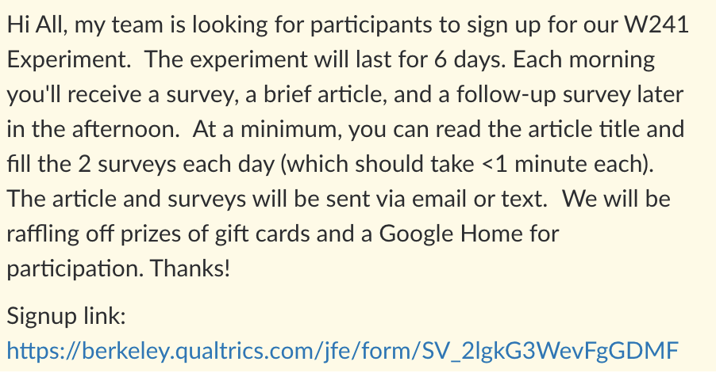
Recruiting Subjects
Gave options for participation via email or text.
The experiment consisted of two surveys each day and lasted four to six days, which had the risk of attrition.
* The survey was redesigned to include an executive summary of the news article as well.

Slide 12
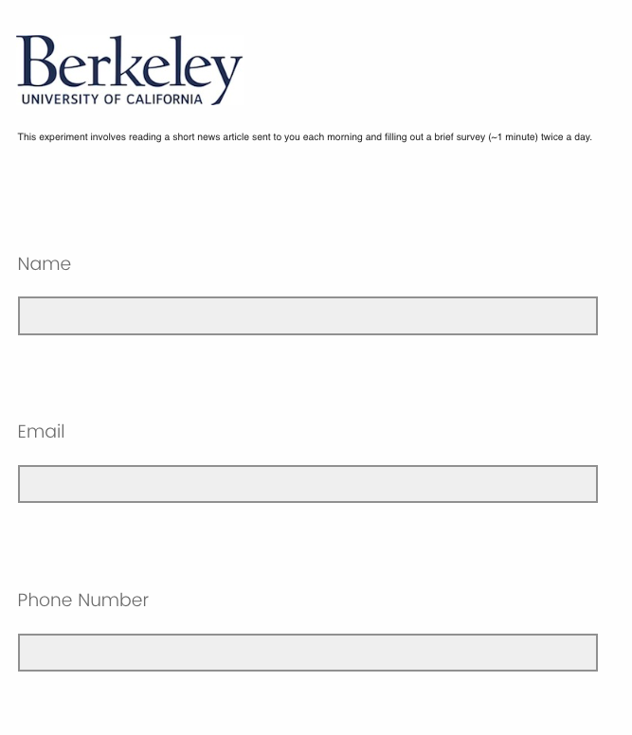
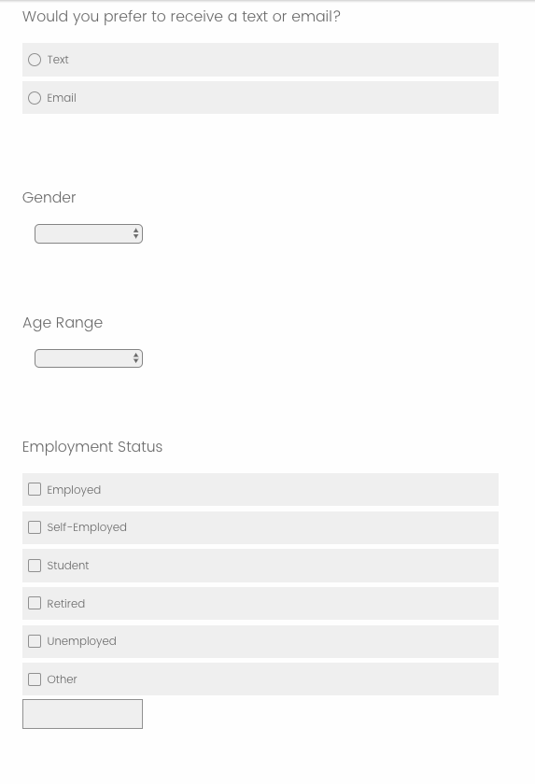
Sign up Form
Information about the subject was collected via a Sign up form.
Age
Gender
Employment status
This information was used to judge if blocking or clustering was necessary and as possible covariates.
Received 59 sign ups.

Slide 13
Randomization
Subjects were randomized into treatment or control independently each day using a random uniform normal distribution `runif(1) > .5`
Daily randomization allowed 59 test subjects over 4 days to be counted as 59 * 4 observations.
Most subjects (~7/8 ) were included in both control and treatment.
Randomization also allows the researchers to control for confounds by switching assignment each day.
No need to block or cluster due to daily randomization and the sparseness of subjects.
Problem with daily randomization: People’s emotions (happiness) may not be independent on a daily level, so there may be a spillover effect.
Solution: Capture baseline mood in the pre-survey to mitigate any spillover effect that may occur with daily randomization

Slide 14
Experimental Design Iterations
Initial Proposal
Iteration One
Pilot Study
Pilot Study Feedback
Post-survey sent at 5 PM
Surveys required text based justification
Duration: 6 days
Considered blocking on age.
Subject randomly assigned to either treatment or control for duration of study
Post-survey sent at 10am
Replaced text based responses with choice based selection.
Added question about potential sources of happiness.
Automated text/email to subjects at designated times.
6 participants
Tested email and text delivery
Duration: 2 days
Pros:
Successful automated delivery
Cons:
Too many questions.
Gap between surveys too short.
Easy to skip reading articles (non-compliance)
Pilot study subjects said they may not have lasted 6 days -- suggested 4 days.

Slide 15
Final Experiment
Outcome is measured by a seven-point Likert scale .
It is derived by subtracting the post survey happiness value by the pre survey happiness value.
Added easy article quiz question to test for non-compliance.
Increased time between pre and post survey by one hour.
Post survey now sent at 11 AM PST.
Sent reminder to all participants 3 days before start of experiment.
Sent final reminder with instructions the night before the experiment.

Slide 16
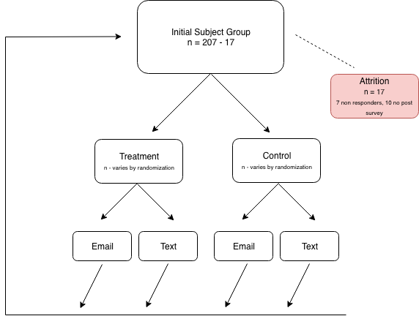
Experiment Flow

Slide 17
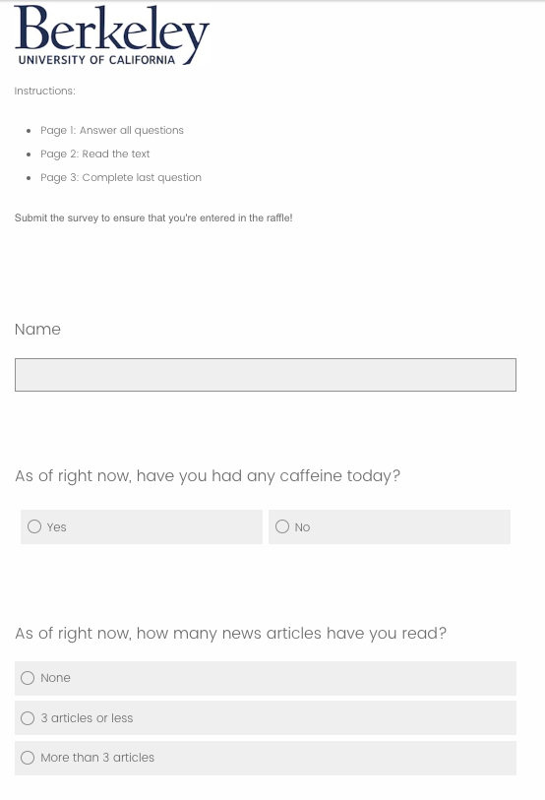
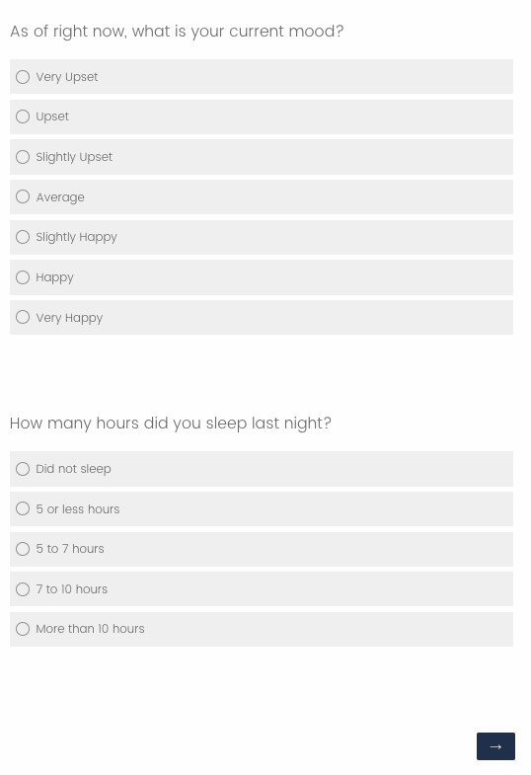
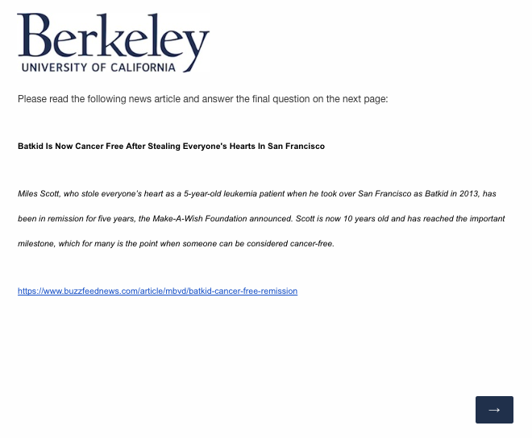
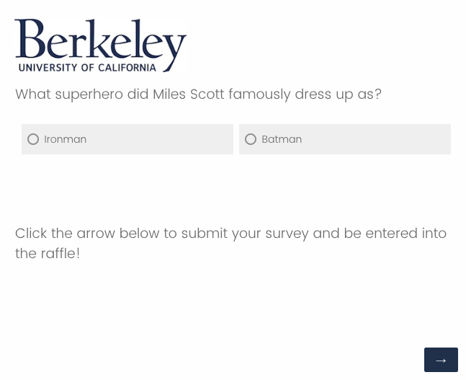
Experiment Example (Treatment - Pre Survey)

Slide 18
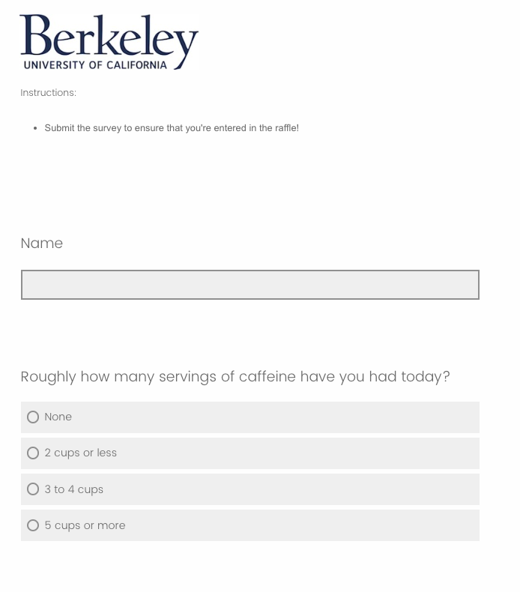
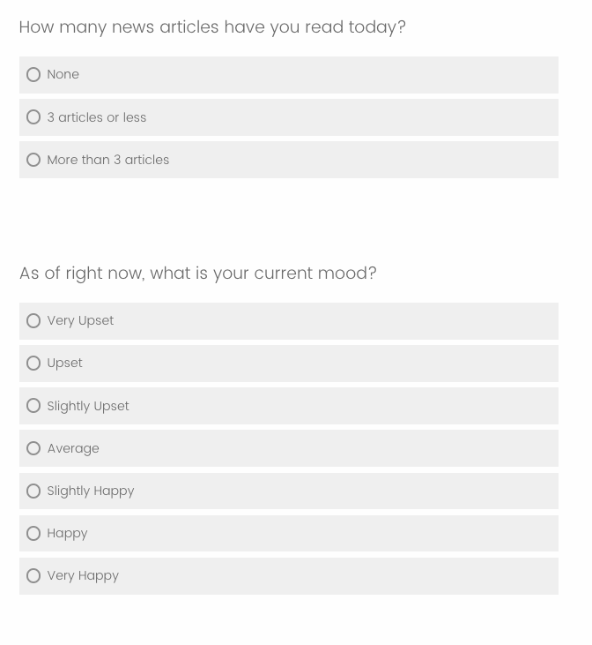
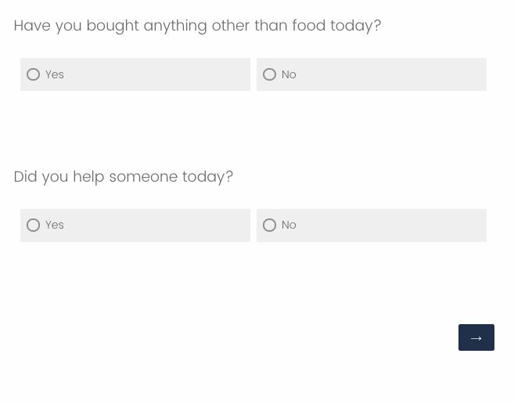
Experiment Example (Treatment - Post Survey)

Slide 19
Data Analysis
Exploratory Data Analysis
Testing methods
Interpretation

Slide 20
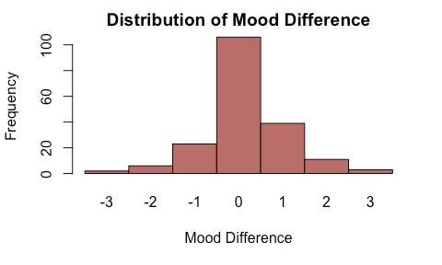
Exploratory Data Analysis
Outcome: Mood Difference
Mood Difference = Post Survey Mood - Pre Survey Mood
Normally distributed
Mean is 0.15
Negative difference symbolizes a drop in the subject’s mood, positive symbolizes an increase, and zero represents no change in mood.

Slide 21
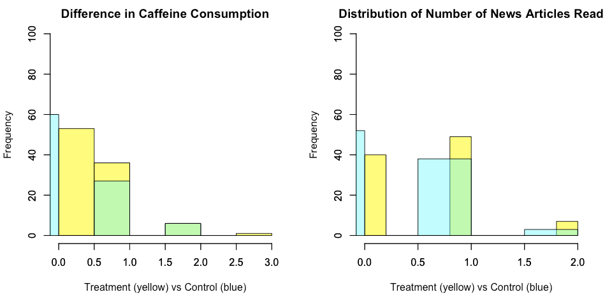
Exploratory Data Analysis
Covariates - differences between post and pre surveys:
Caffeine consumption
Number of news articles read
Visually inspected distribution to find anomalies or any indication of a failure in randomization.
Both distributions look similar and randomly distributed.

Slide 22
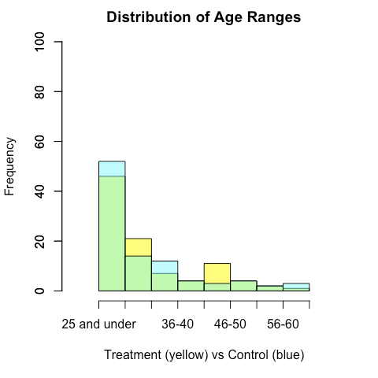
Exploratory Data Analysis
Covariates - Age Range:
The distribution of age range shows that the randomization evenly split subjects to treatment and control.
There is a large cluster of people between 25-35 years old.

Slide 23
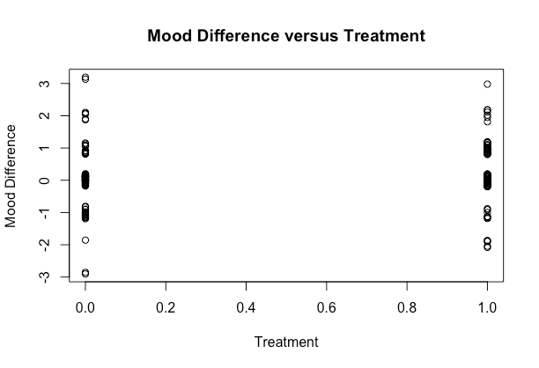
Testing Methods
Considering a categorical dependent variable (Mood Difference), a regression may not give an accurate representation of the relationship.
Relationship between outcome and treatment was tested with:
Randomization Inference
10,000 simulated random assignments under the sharp null hypothesis.
Mann-Whitney U Test
Non-parametric equivalent of the independent sample t-test.
Outcome variable - ranked variable (Happiness)
Predictor variable - categorical variable (different news type)

Slide 24
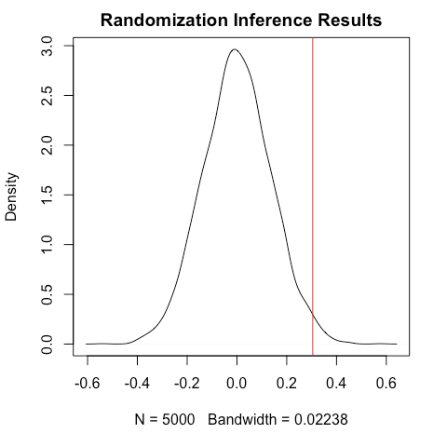
Randomization Inference
Despite attrition (minimal and not included in analysis since there is no outcome), each subject passed the compliance test. Therefore, ATE can be calculated instead of CACE.
Calculated ATE:
0.1968085
Sampled 1000, 5000, and 10000 times.
All yield a p-value > 0.05
ATE is not statistically significant.

Slide 25
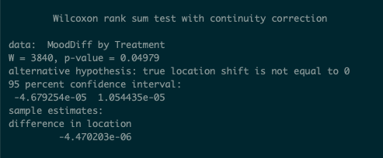
Mann-Whitney U Test Overall
Used to test if there is any significant difference between treatment and control outcomes.
Null hypothesis is that there is no difference.
P-value was at the significance level (<.05); however,
Confidence interval contains zero: between -0.000046 and 0.000010
Conclusion : The “uplifting news” did not affect participants happiness at the end of the day. There might be other factors

Slide 26
Final Thoughts
Questions
The EDA yielded an interesting result that the there was a large cluster of people who were between 25-35. We filtered our data for this group and conducted similar tests and found significance. We discuss this in our report but also discuss the fear of potentially p-hacking. Thoughts?
Concerns
We were not able to add many covariates into our analysis due to limitations of randomization inference. Ideally we would have had more samples that we could group by and conduct randomization inference tests on.
Having subjects report their happiness level added a lot of subjectivity to the result. If there is a next iteration of this experiment, we will look into other measures of happiness.
Questions and Concerns

Slide 27
Questions and/or Feedback?
Thank you.

